Slide 1

MODELING OF HIGH PERFORMANCE PROGRAMS TO SUPPORT HETEROGENEOUS COMPUTING
FEROSH JACOB
Department of Computer Science
The University of Alabama
Ph.D. committee
Dr. Jeff Gray, COMMITTEE CHAIR
Dr. Purushotham Bangalore
Dr. Jeffrey Carver
Dr. Yvonne Coady
Dr. Brandon Dixon
Dr. Nicholas Kraft
Dr. Susan Vrbsky
Ph. D. defense
Feb 18, 2013

Slide 2


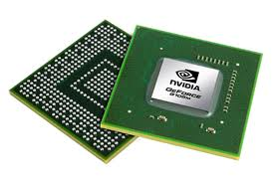
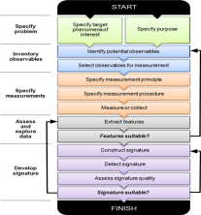
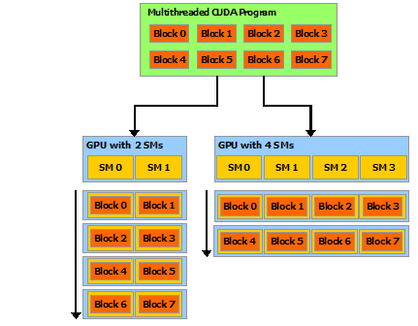
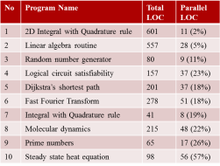
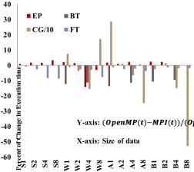
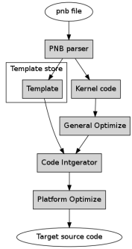
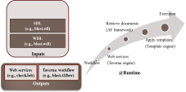
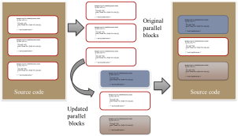
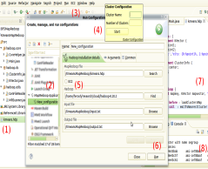
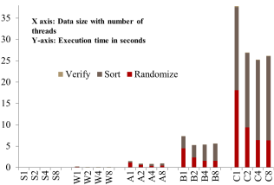
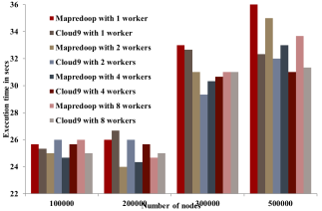
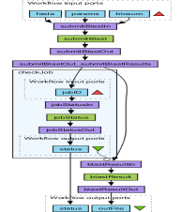
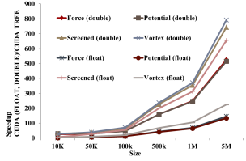
Overview of Presentation
Multi-core
Processors
Introduction
Parallel
Programming
Challenges
How?
Who?
What?
Solutions
Which?
Approach
Evaluation & Case Studies
SDL & WDL
PPModel
MapRedoop
PNBsolver
IS Benchmark
BFS
BLAST
Gravitational Force
PPModel
MapRedoop
SDL & WDL
PNBsolver
2

Slide 3
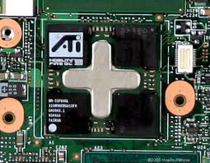
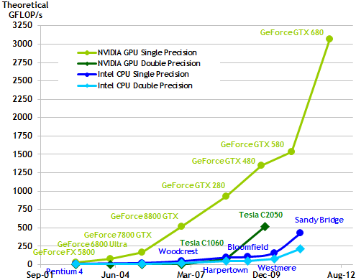
Parallel Programming
Multicore processors have gained much popularity recently as semiconductor manufactures battle the “power wall” by introducing chips with two (dual) to four (quad) processors.
Introduction of multi-core processors has increased the computational power.
Parallel programming has emerged as one of the essential skills needed by next generation software engineers.
*Plot taken from NVIDIA CUDA user guide

Slide 4
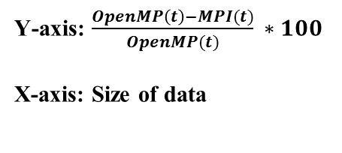
Parallel Programming Challenges
Which programming model to use?

Slide 5
Parallel Programming Challenges
For size B, when executed with two instances (B2), benchmarks EP and CG executed faster than OpenMP. However, with four instances (B4), the MPI version executed faster in OpenMP.
There is a distinct need for creating and maintaining multiple versions of the same program for different problem sizes, which in turn leads to code maintenance issues.

Slide 6
Parallel Programming Challenges
No | Program Name | Total LOC | Parallel LOC
1 | 2D Integral with Quadrature rule | 601 | 11 (2%)
2 | Linear algebra routine | 557 | 28 (5%)
3 | Random number generator | 80 | 9 (11%)
4 | Logical circuit satisfiability | 157 | 37 (23%)
5 | Dijkstra’s shortest path | 201 | 37 (18%)
6 | Fast Fourier Transform | 278 | 51 (18%)
7 | Integral with Quadrature rule | 41 | 8 (19%)
8 | Molecular dynamics | 215 | 48 (22%)
9 | Prime numbers | 65 | 17 (26%)
10 | Steady state heat equation | 98 | 56 (57%)
The LOC of the parallel blocks to the total LOC of the program ranges from 2% to 57%, with an average of 19%.
To create a different execution environment for any of these programs, more than 50% of the total
LOC would need to be rewritten for most of the programs due to redundancy of the same parallel code in many places.
Why are parallel programs long?
*Detailed openMP analysis http://fjacob.students.cs.ua.edu/ppmodel1/omp.html
*Programs taken from John Burkardt’s benchmark programs, http://people.sc.fsu.edu/~jburkardt/

Slide 7
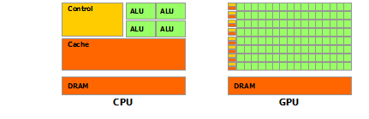
Parallel Programming Challenges
A multicore machine can deliver the optimum performance when executed with n1 number of threads allocating m1 KB of memory, n2 number of processes allocating m2 KB of memory, or n2 number of processes with each process having n2 number of threads and allocating m2 KB of memory for each process.
What are the execution parameters?
*Images taken from NVIDIA CUDA user guide

Slide 8
Parallel Programming Challenges
No | Step description
1 | create the OpenCL context on available GPU devices
2 | if user specified GPU/GPUs create command queue for each
3 | else find how many available GPUs create command queues for all create a command queue for device0 or a given device
4 | program set up load program from file create the program build the program create kernel run calculation on the queues or queue
5 | clean OpenCL resources
In the OpenCL programs analyzed, 33% (5) of the programs used multiple devices while 67% (10) used a single device for execution.
From the CUDA examples, any GPU call could be considered as a three-step process:
copy or map the variables before the execution
execute on the GPU
copy back or unmap the variables after the execution
How do Technical Details Hide the Core Computation?
*Ferosh Jacob, David Whittaker, Sagar Thapaliya, Purushotham Bangalore, Marjan Mernik, and Jeff Gray, "CUDACL: A Tool for CUDA and OpenCL Programmers,” in Proceedings of the 17th International Conference on High Performance Computing, Goa, India, December 2010, 11 pages.

Slide 9
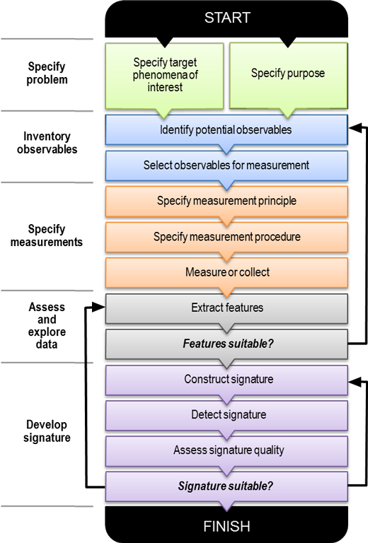
Parallel Programming Challenges
Many scientists are not familiar with service-oriented software technologies, a popular strategy for developing and deploying workflows.
The technology barrier may degrade the efficiency of sharing signature discovery algorithms, because any changes or bug fixes of an algorithm require a dedicated software developer to navigate through the engineering process.
Who can use HPC programs?
*Image taken from PNNL SDI project web page.

Slide 10
Summary: Parallel Programming Challenges
Which programming model to use?
Why are parallel programs long?
What are the execution parameters?
How do technical details hide the core computation?
Who can use HPC programs?

Slide 11
Solution Approach: Modeling HPC Programs
Domain (Abstraction level) | Application | Solution
Code | C and FORTRAN programs | PPModel
Algorithm | MapReduce programs | MapRedoop
Program | Signature Discovery programs | SDL & WDL
Sub-domain | Nbody problems | PNBsolver

Slide 12
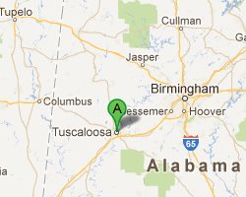
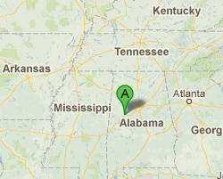
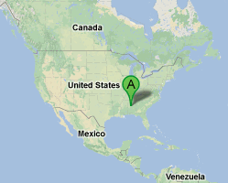

Why Abstraction Levels?
“What are your neighboring places?”
*Images taken from Google maps

Slide 13
PPModel : Code-level Modeling
Domain (Abstraction level) | Application | Solution
Code | C and FORTRAN programs | PPModel*
Algorithm | MapReduce programs | MapRedoop
Program | Signature Discovery programs | SDL & WDL
Sub-domain | Nbody problems | PNBsolver
*Project website: https://sites.google.com/site/tppmodel/

Slide 14

PPModel Motivation: Multiple Program Versions
p-threads
CUDA
OpenCL
OpenMPI
Cg
OpenMP

Slide 15
#pragma omp for schedule(dynamic,chunk)
for (i=0; i<N; i++)
{
c[i] = a[i] + b[i];
printf("Thread %d: c[%d]= %f\n",tid,i,c[i]);
}
} /* end of parallel section */
#pragma omp for schedule(dynamic,chunk)
for (i=0; i<N; i++)
{
c[i] = a[i] + b[i];
printf("Thread %d: c[%d]= %f\n",tid,i,c[i]);
}
} /* end of parallel section */
Original
parallel
blocks
#pragma omp for schedule(dynamic,chunk)
for (i=0; i<N; i++)
{
c[i] = a[i] + b[i];
printf("Thread %d: c[%d]= %f\n",tid,i,c[i]);
}
} /* end of parallel section */
#pragma omp for schedule(dynamic,chunk)
for (i=0; i<N; i++)
{
c[i] = a[i] + b[i];
printf("Thread %d: c[%d]= %f\n",tid,i,c[i]);
}
} /* end of parallel section */
#pragma omp for schedule(dynamic,chunk)
for (i=0; i<N; i++)
{
c[i] = a[i] + b[i];
printf("Thread %d: c[%d]= %f\n",tid,i,c[i]);
}
} /* end of parallel section */
#pragma omp for schedule(dynamic,chunk)
for (i=0; i<N; i++)
{
c[i] = a[i] + b[i];
printf("Thread %d: c[%d]= %f\n",tid,i,c[i]);
}
} /* end of parallel section */
#pragma omp for schedule(dynamic,chunk)
for (i=0; i<N; i++)
{
c[i] = a[i] + b[i];
printf("Thread %d: c[%d]= %f\n",tid,i,c[i]);
}
} /* end of parallel section */
#pragma omp for schedule(dynamic,chunk)
for (i=0; i<N; i++)
{
c[i] = a[i] + b[i];
printf("Thread %d: c[%d]= %f\n",tid,i,c[i]);
}
} /* end of parallel section */
#pragma omp for schedule(dynamic,chunk)
for (i=0; i<N; i++)
{
c[i] = a[i] + b[i];
printf("Thread %d: c[%d]= %f\n",tid,i,c[i]);
}
} /* end of parallel section */
#pragma omp for schedule(dynamic,chunk)
for (i=0; i<N; i++)
{
c[i] = a[i] + b[i];
printf("Thread %d: c[%d]= %f\n",tid,i,c[i]);
}
} /* end of parallel section */
Source code
Source code
#pragma omp for schedule(dynamic,chunk)
for (i=0; i<N; i++)
{
c[i] = a[i] + b[i];
printf("Thread %d: c[%d]= %f\n",tid,i,c[i]);
}
} /* end of parallel section */
Updated
parallel
blocks
#pragma omp for schedule(dynamic,chunk)
for (i=0; i<N; i++)
{
c[i] = a[i] + b[i];
printf("Thread %d: c[%d]= %f\n",tid,i,c[i]);
}
} /* end of parallel section */
PPModel Overview

Slide 16
PPModel: Three Stages of Modeling
PPModel Methodology
Stage 1. Separation of parallel and sequential sections
Hotspots (parallel sections) are separated from sequential parts to improve code evolution and portability (Modulo-F).
Stage 2. Modeling parallel sections to an execution device
Parallel sections may be targeted to different languages using a configuration file (tPPModel).
Stage 3. Expressing parallel computation using a Templates
A study was conducted that identifies frequently used patterns in GPU programming.

Slide 17
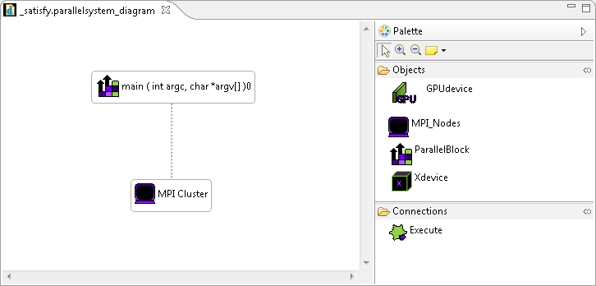
PPModel: Eclipse Plugin
*Demo available at http://fjacob.students.cs.ua.edu/ppmodel1/default.html

Slide 18
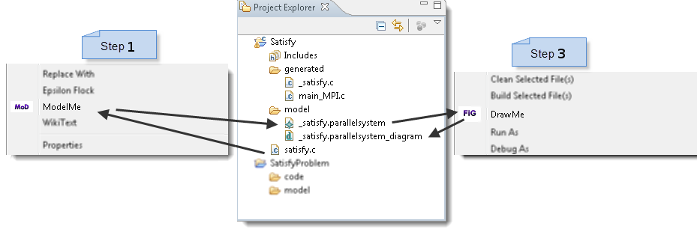
PPModel: Eclipse Plugin
*Demo available at http://fjacob.students.cs.ua.edu/ppmodel1/default.html

Slide 19
PPModel in Action
Size | CUDA
S | 0.169
W | 2.065
A | 12.6
B | 26.6
C | 38.0
CUDA speedup for Randomize function
*Classes used to define size in NAS Parallel Benchmarks (NPB): 1) S (2¹⁶), W (2²⁰), A (2²³), B (2²⁵), and C (2²⁷).

Slide 20
PPModel in Action

Slide 21
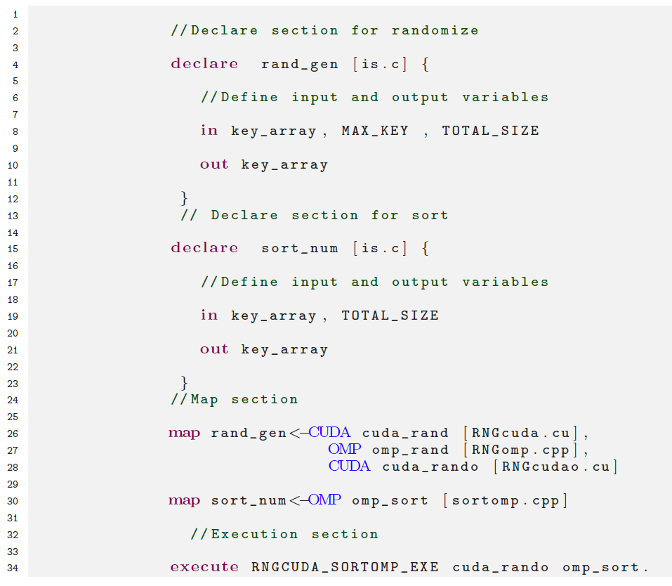
PPModel in Action

Slide 22
PPModel in Action

Slide 23
PPModel Summary
PPModel is designed to assist programmers while porting a program from a sequential to a parallel version, or from one parallel library to another parallel library.
Using PPModel, a programmer can generate OpenMP (shared), MPI (distributed), and CUDA (GPU) templates.
PPModel can be extended easily by adding more templates for the target paradigm.
Our approach is demonstrated with an Integer Sorting (IS) benchmark program. The benchmark executed 5x faster than the sequential version and 1.5x than the existing OpenMP implementation.
Publications
Ferosh Jacob, Jeff Gray, Jeffrey C. Carver, Marjan Mernik, and Purushotham Bangalore, “PPModel: A Modeling Tool for Source Code Maintenance and Optimization of Parallel Programs,” The Journal of Supercomputing, vol. 62, no 3, 2012, pp. 1560-1582.
Ferosh Jacob, Yu Sun, Jeff Gray, and Purushotham Bangalore, “A Platform-independent Tool for Modeling Parallel Programs,” in Proceedings of the 49th ACM Southeast Regional Conference, Kennesaw, GA, March 2011, pp. 138-143.
Ferosh Jacob, Jeff Gray, Purushotham Bangalore, and Marjan Mernik, “Refining High Performance FORTRAN Code from Programming Model Dependencies,” in Proceedings of the 17th International Conference on High Performance Computing (Student Research Symposium), Goa, India, December 2010, pp. 1-5.

Slide 24

MapRedoop: Algorithm-level Modeling
Domain (Abstraction level) | Application | Solution
Code | C and FORTRAN programs | PPModel*
Algorithm | MapReduce programs | MapRedoop*
Program | Signature Discovery programs | SDL & WDL
Sub-domain | Nbody problems | PNBsolver
*Project website: https: //sites.google.com/site/mapredoop/

Slide 25





Cloud Computing and MapReduce
In our context…
Cloud Computing is a special infrastructure for executing specific HPC programs written using the MapReduce style of programming.
Iaas
Paas
Saas

Slide 26


MapReduce: A Quick Review
MapReduce model allows:
1) partitioning the problem into smaller sub-problems
2) solving the sub-problems
3) combining the results from the smaller sub-problems to solve the original issue
MapReduce involves two main computations:
Map: implements the computation logic for the sub-problem; and
Reduce: implements the logic for combining the sub-problems to solve the larger problem

Slide 27

MapReduce Implementation in Java (Hadoop)
Accidental complexity:
Input Structure
Mahout (a library for machine learning and data-mining programs) expects a vector as an input; however, if the input structure differs, the programmer has to rewrite the file to match the structure that Mahout supports.
<x1,x2,x3>
x1 x2 x3
x1,x2,x3
x1-x2-x3
[x1,x2,x3]
{x1,x2,x3}
{x1 x2 x3}
(1,2,3)

Slide 28

MapReduce Implementation in Java (Hadoop)
Program Comprehension:
Where are my key classes?
Currently, the MapReduce programmer has to search within the source code to identify the mapper and the reducer (and depending on the program, the partitioner and combiner).
There is no central place where the required input values for each of these classes can be identified in order to increase program comprehension.

Slide 29

MapReduce Implementation in Java (Hadoop)
Error Checking:
Improper Validation
Because the input and output for each class (mapper, partitioner, combiner, and reducer) are declared separately, mistakes are not identified until the entire program is executed.
change instance of the IntWritable data type to FloatWritable
type mismatch in key from map
output of the mapper must match the type of the input of the reducer

Slide 30
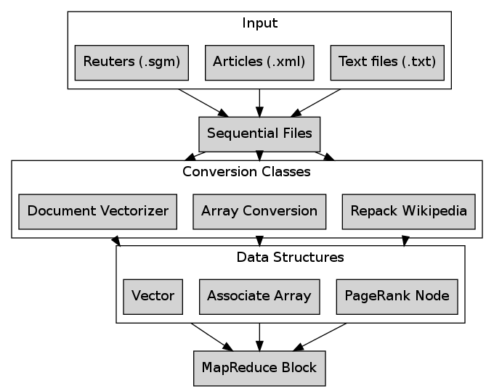
Hadoop: Faster Sequential Files

Slide 31
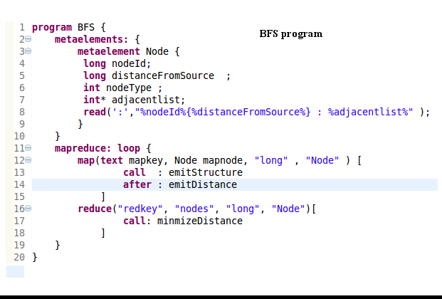
MapRedoop: BFS Case Study

Slide 32
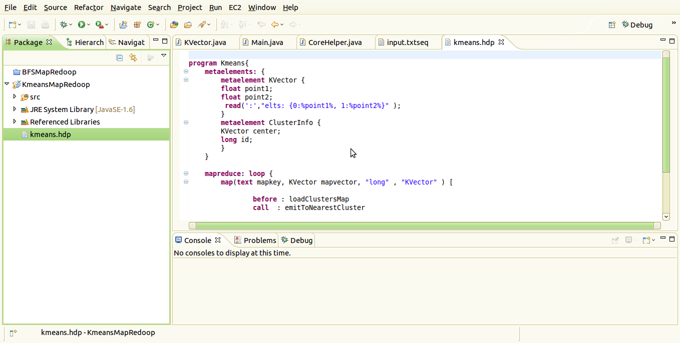
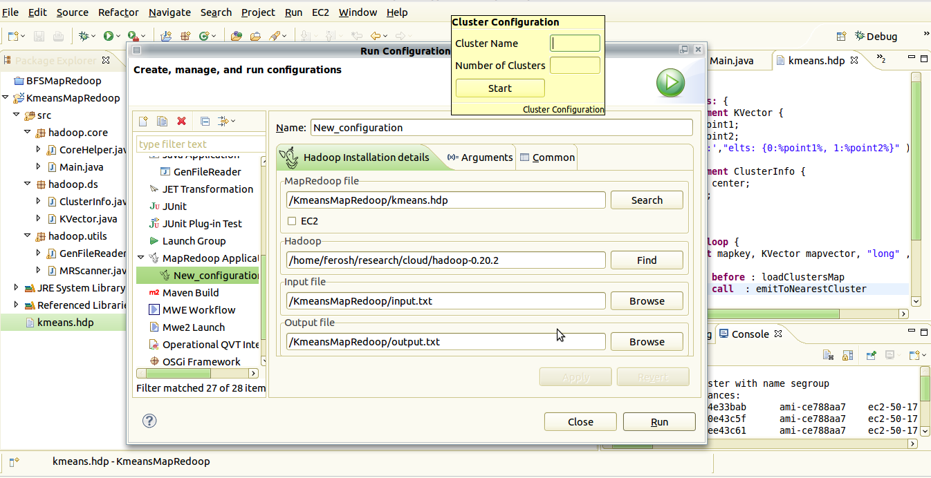
MapRedoop: Eclipse IDE Deployer

Slide 33
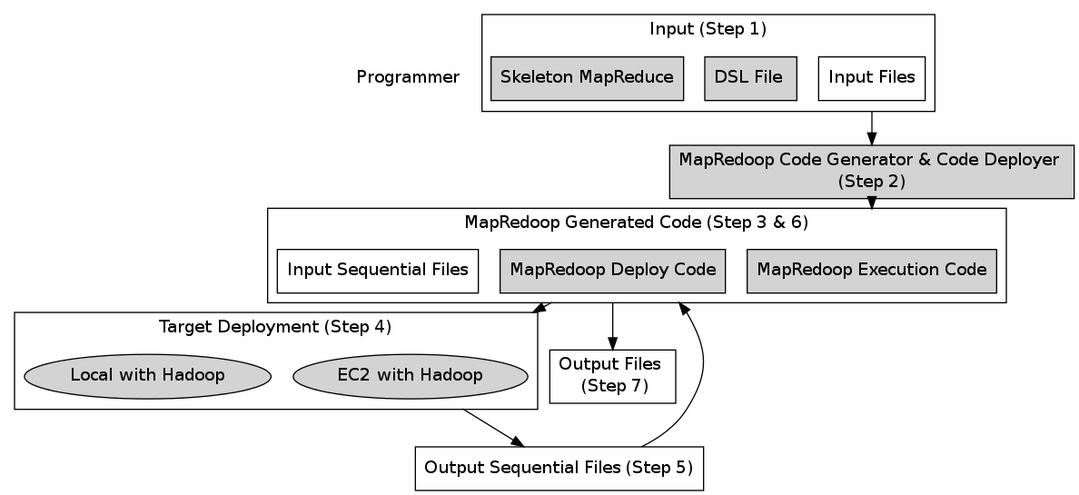
MapRedoop: Design Overview

Slide 34
MapRedoop: BFS and Cloud9 Comparison

Slide 35
MapRedoop: BFS and Cloud9 Comparison

Slide 36
MapRedoop Summary
MapRedoop is a framework implemented in Hadoop that combines a DSL and IDE that removes the encountered accidental complexities. To evaluate the performance of our tool, we implemented two commonly described algorithms (BFS and K-means) and compared the execution of MapRedoop to existing methods (Cloud9 and Mahout).
Publications
Ferosh Jacob, Amber Wagner, Prateek Bahri, Susan Vrbsky, and Jeff Gray, “Simplifying the Development and Deployment of Mapreduce Algorithms,” International Journal of Next-Generation Computing (Special Issue on Cloud Computing, Yugyung Lee and Praveen Rao, eds.), vol. 2, no. 2, 2011, pp. 123-142.

Slide 37

SDL & WDL: Program-level Modeling
Domain (Abstraction level) | Application | Solution
Code | C and FORTRAN programs | PPModel*
Algorithm | MapReduce programs | MapRedoop*
Program | Signature Discovery programs | SDL & WDL
Sub-domain | Nbody problems | PNBsolver
In collaboration with:

Slide 38

Signature Discovery Initiative (SDI)
The most widely understood signature is the human fingerprint.
Anomalous network traffic is often an indicator of a computer virus or malware.
Biomarkers can be used to indicate the presence of disease or identify a drug resistance.
Combinations of line overloads that may lead to a cascading power failure.

Slide 39
SDI High-level Goals
Anticipate future events by detecting precursor signatures, such as combinations of line overloads that may lead to a cascading power failure
Characterize current conditions by matching observations against known signatures, such as the characterization of chemical processes via comparisons against known emission spectra
Analyze past events by examining signatures left behind, such as the identity of cyber hackers whose techniques conform to known strategies and patterns

Slide 40
SDI Analytic Framework (AF)
Challenge:
An approach is needed that can be applied across a broad spectrum to efficiently and robustly construct candidate signatures, validate their reliability, measure their quality and overcome the challenge of detection.
Solution: Analytic Framework (AF)
Legacy code in a remote machine is wrapped and exposed as web services
Web services are orchestrated to create re-usable tasks that can be retrieved and executed by users

Slide 41
Challenges for Scientists Using AF
Accidental complexity of creating service wrappers
In our system, manually wrapping a simple script that has a single input and output file requires 121 lines of Java code (in five Java classes) and 35 lines of XML code (in two files).
Lack of end-user environment support
Many scientists are not familiar with service-oriented software technologies, which force them to seek the help of software developers to make Web services available in a workflow workbench.
We applied Domain-Specific Modeling (DSM) techniques to
Model the process of wrapping remote executables.
The executables are wrapped inside AF web services using a Domain-Specific Language (DSL) called the Service Description Language (SDL).
Model the SDL-created web services
The SDL-created web services can then be used to compose workflows using another DSL, called the Workflow Description Language (WDL).

Slide 42
Example Application: BLAST execution
Submit BLAST job in a cluster
Check the status of the job
Download the output files upon completion of the job.
Three steps for executing a BLAST job

Slide 43
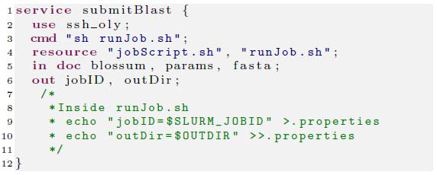
Service Description Language (SDL)
Service description (SDL) for BLAST submission

Slide 44
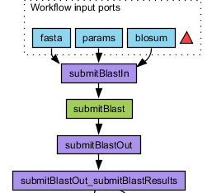
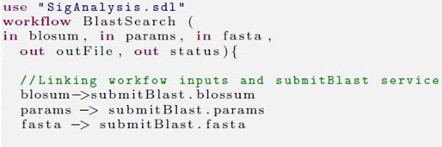
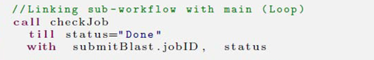
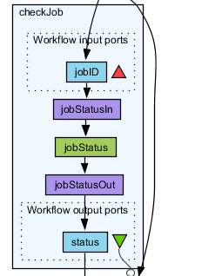
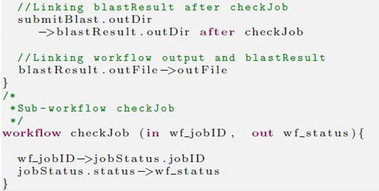
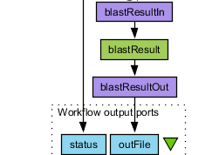
Output Generated as Taverna Workflow Executable
Workflow description (WDL) for BLAST

Slide 45
Output Generated as Taverna Workflow Executable
Workflow description (WDL) for BLAST

Slide 46
Output Generated as Taverna Workflow Executable
Workflow description (WDL) for BLAST

Slide 47
SDL/WDL Implementation
Workflow
Web services
(Taverna engine)
Retrieve documents
(AF framework)
Apply templates
(Template engine)
Execution
Script metadata
(e.g., name, inputs)
SDL
(e.g., blast.sdl)
WDL
(e.g., blast.wdl)
Inputs
Outputs
Web services
(e.g., checkJob)
Taverna workflow
(e.g., blast.t2flow)
@Runtime

Slide 48
SDL/WDL Summary
Successfully designed and implemented two DSLs (SDL and WDL) for converting remote executables into scientific workflows
SDL can generate services that are deployable in a signature discovery workflow using WDL
Currently, the generated code is used in two projects: SignatureAnalysis and SignatureQuality
Publications
Ferosh Jacob, Adam Wynne, Yan Liu, and Jeff Gray, “Domain-Specific Languages For Developing and Deploying Signature Discovery Workflows,” Computing in Science and Engineering, 15 pages (in submission).
Ferosh Jacob, Adam Wynne, Yan Liu, Nathan Baker, and Jeff Gray, “Domain-Specific Languages for Composing Signature Discovery Workflows,” in Proceedings of the 12th Workshop on Domain-Specific Modeling, Tucson, AZ, October 2012, pp. 61-62.

Slide 49
PNBsolver: Sub-domain-level Modeling
Domain (Abstraction level) | Application | Solution
Code | C and FORTRAN programs | PPModel
Algorithm | MapReduce programs | MapRedoop
Program | Signature Discovery programs | SDL & WDL
Sub-domain | Nbody problems | PNBsolver*
In collaboration with:
Dr. Weihua Geng
Assistant Professor
Department of Mathematics
University of Alabama
*Project website: https: https://sites.google.com/site/nbodysolver/

Slide 50
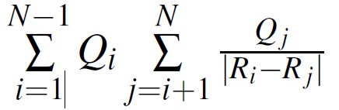
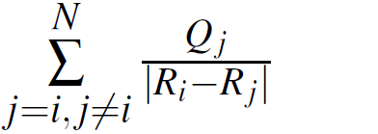
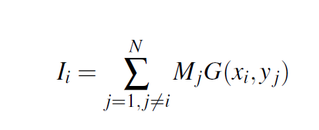
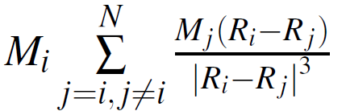
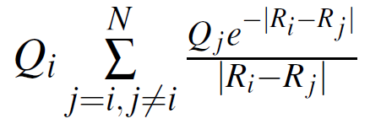
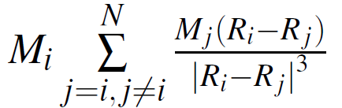
Nbody Problems and Tree Code Algorithm
Astrophysics
Plasma physics
Molecular physics
Fluid dynamics
Quantum chromo-dynamics
Quantum chemistry

Slide 51
Tree Code Algorithm and Direct Summation
Direct code: O (N²)
Tree code : O (NlogN)

Slide 52
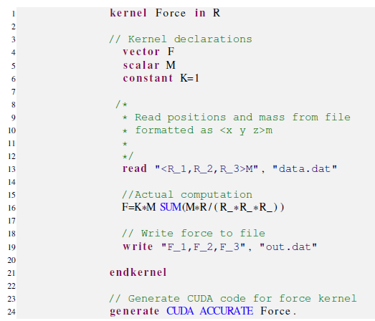
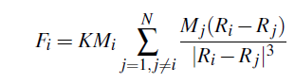
PNBsolver Example: Gravitation Force

Slide 53
PNBsolver: Modes of Operation
Platform | Mode | Algorithm | Parameters
GPU (CUDA) | ACCURATE AVERAGE FAST | DIRECT DIRECT TREE | DOUBLE FLOAT
CPU (OpenMP & MPI) | ACCURATE AVERAGE FAST | TREE TREE TREE | ORDER=6 ORDER=4 ORDER=1

Slide 54
PNBsolver: Effect of order in Error and Time

Slide 55
PNBsolver: Speedup of CUDA Tree Code

Slide 56
PNBsolver Comparison: Handwritten v/s Generated

Slide 57
PNBsolver Summary
PNBsolver can be executed in three modes:
FAST
AVERAGE
ACCURATE
Two programming languages
Three parallel programming paradigms
Two algorithms
Comparison of the execution time of the generated code with that of handwritten code by expert programmers indicated that the execution time is not compromised
Publications
Ferosh Jacob, Ashfakul Islam, Weihua Geng, Jeff Gray, Brandon Dixon, Susan Vrbsky, and Purushotham Bangalore, “PNBsolver: A Case Study on Modeling Parallel N-body Programs,” Journal of Parallel and Distributed Computing, 26 pages (in submission).
Weihua Geng and Ferosh Jacob, “A GPU Accelerated Direct-sum Boundary Integral Poisson-Boltzmann Solver,” Computer Physics Communications, 14 pages (accepted for publication on January 23, 2013).

Slide 58
Summary
Core Issues Addressed in this Dissertation:
Which programming model to use?
Why are parallel programs long?
What are the execution parameters?
How do technical details hide the core computation?
Who can use HPC programs?
Overview of Solution Approach:
We identified four abstraction levels in HPC programs and used software modeling to provide tool support for users at these abstraction levels.
PPModel (code)
MapRedoop (algorithm)
SDL & WDL (program)
PNBsolver (sub-domain)
Our research suggests that using the newly introduced abstraction levels, it is possible to support heterogeneous computing, reduce execution time, and improve source code maintenance through better code separation.

Slide 59
Related Work
Parallel Programming
Sequential to parallel converters
Automatic
Conversion
Parallel to parallel converters
OpenMP to GPGPU,
OpenMP to MPI
Software modeling
Source code transformation
DSLs for parallel programing
Graphical programming languages
DSM
AOP
User Interaction
PFC, ALT
PAT, CUDACL
HiCUDA, CUDA-Lite, Sawzall
CODE, GASPARD
SPL to CPL
AspectJ for MPI programs
GPU languages
Cg
Brook
CUDA abstractions
hiCUDA
CUDA-lite
OpenCL
CalCon
PGI compiler
CuPP framework

Slide 60
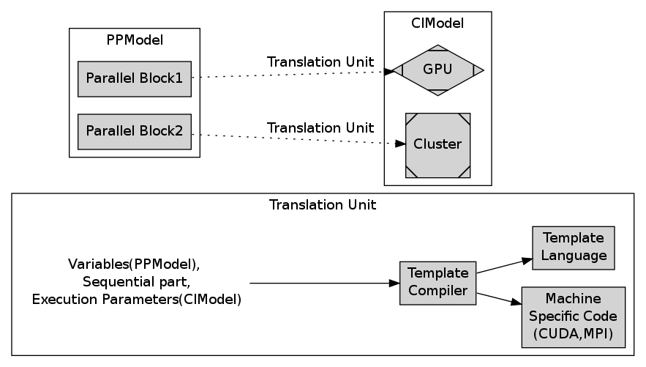
Future Work
Human-based Empirical Studies on HPC Applications
Hypothesis: “HPC applications often require systematic and repetitive code changes”
Extending PPModel to a Two-Model Approach for HPC Programs

Slide 61
Core Contributions
We identiﬁed four diﬀerent levels of applying modeling techniques to such problems:
Code: A programmer is given ﬂexibility to insert, update, or remove an existing code section and hence this technique is independent of any language or execution platform.
Algorithm: This is targeted for MapReduce programmers, and provides an easier interface for developing and deploying MapReduce programs in Local and EC2 cloud.
Program: Program-level modeling is applied for cases when scientists have to create, publish, and distribute a workﬂow using existing program executables.
Sub-domain: Sub-domain-level modeling can be valuable to specify the problem hiding all the language-speciﬁc details, but providing the optimum solution. We applied this successfully on N-body problems.

Slide 62
Publications
Workshops and short papers
Ferosh Jacob, Adam Wynne, Yan Liu, Nathan Baker, and Jeff Gray, “Domain-specifc Languages for Composing Signature Discovery Workflows,” in Proceeding of the 12th Workshop on Domain-Specifc Modeling, Tucson, AZ, October 2012, pp. 81-83..
Robert Tairas, Ferosh Jacob and Jeﬀ Gray, “Representing Clones in a Localized Manner”, in Proceedings of the 5th International Workshop on Software Clones, Waikiki, Hawaii, May 2011, pp. 54-60..
Ferosh Jacob, Jeﬀ Gray, Purushotham Bangalore, and Marjan Mernik, “Reﬁning High Performance FORTRAN Code from Programming Model Dependencies,” in Proceedings of the 17th International Conference on High Performance Computing Student Research Symposium, Goa, India, December 2010, pp. 1-5.
Ferosh Jacob, Daqing Hou, and Patricia Jablonski, “Actively Comparing Clones Inside the Code Editor,” in Proceedings of the 4th International Workshop on Software Clones, Cape Town, South Africa, May 2010, pp. 9-16.
Daqing Hou, Ferosh Jacob, and Patricia Jablonski, “Proactively Managing Copy-and-Paste Induced Code Clones,” in Proceedings of the 25th International Conference on Software Maintenance, Alberta, Canada, September 2009, pp. 391-392.
Daqing Hou, Ferosh Jacob, and Patricia Jablonski, “CnP: Towards an Environment for the Proactive Management of Copy-and-Paste Programming,” in Proceedings of the 17th International Conference on Program Comprehension, British Columbia, Canada, May 2009, pp. 238-242.
Refereed presentations
“Modulo-X: A Simple Transformation Language for HPC Programs," Southeast Regional Conference, Tuscaloosa, AL, March 2012 (Poster).
“CUDACL+: A Framework for GPU Programs,” International Conference on Object-Oriented Programming, Systems, Languages, and Applications (SPLASH/OOPSLA), Portland, OR, October 2011 (Doctoral Symposium).
“Refining High Performance FORTRAN Code from Programming Model Dependencies" International Conference on High Performance Computing Student Research Symposium, Goa, India, December 2010 (Poster). Best Presentation Award
“Extending Abstract APIs to Shared Memory," International Conference on Object-Oriented Programming, Systems, Languages, and Applications (SPLASH/OOPSLA), Reno, NV, October 2010 (Student Research Competition). Bronze Medal
“CSeR: A Code Editor for Tracking and Highlighting Detailed Clone Differences," International Conference on Object-Oriented Programming, Systems, Languages, and Applications (OOPSLA) Refactoring Workshop, Orlando, FL, October 2009 (Poster).
Journals
Ferosh Jacob, Jeff Gray, Jeffrey C. Carver, Marjan Mernik, and Purushotham Bangalore, “PPModel: A Modeling Tool for Source Code Maintenance and Optimization of Parallel Programs,” The Journal of Supercomputing, vol. 62, no 3, 2012, pp. 1560-1582.
Ferosh Jacob, Sonqging Yue, Jeff Gray, and Nicholas Kraft, “SRLF: A Simple Refactoring Language for High Performance FORTRAN,” Journal of Convergence Information Technology, vol. 7, no. 12, 2012, pp. 256-263.
Ferosh Jacob, Amber Wagner, Prateek Bahri, Susan Vrbsky, and Jeff Gray, “Simplifying the Development and Deployment of MapReduce Algorithms,” International Journal of Next-GenerationComputing (Special Issue on Cloud Computing, Yugyung Lee and Praveen Rao, eds.), vol. 2, no. 2, 2011, pp. 123-142.
Ferosh Jacob, Adam Wynne, Yan Liu, Nathan Baker, and Jeff Gray, “Domain-Specifc Languages For Developing and Deploying Signature Discovery Workflows,” Computing in Science and Engineering, 15 pages (in submission).
Ferosh Jacob, Ashfakul Islam, Weihua Geng, Jeff Gray, Brandon Dixon, Susan Vrbsky, and Purushotham Bangalore, “PNBsolver: A Case Study on Modeling Parallel N-body Programs,” Journal of Parallel and Distributed Computing, 26 pages (in submission).
Weihua Geng and Ferosh Jacob, “A GPU Accelerated Direct-sum Boundary Integral Poisson-Boltzmann Solver,” Computer Physics Communications, 14 pages (accepted for publication on January 23, 2013).
Conference papers
Ferosh Jacob, Yu Sun, Jeﬀ Gray, and Puri Bangalore, “A Platform-independent Tool for Modeling Parallel Programs,” in Proceedings of the 49th ACM Southeast Regional Conference, Kennesaw, GA, March 2011, pp. 138-143.
Ferosh Jacob, David Whittaker, Sagar Thapaliya, Purushotham Bangalore, Marjan Mernik, and Jeﬀ Gray, “CUDACL: A Tool for CUDA and OpenCL programmers,” in Proceedings of the 17th International Conference on High Performance Computing, Goa, India, December 2010, pp. 1-11.
Ferosh Jacob, Ritu Arora, Purushotham Bangalore, Marjan Mernik, and Jeﬀ Gray, “Raising the Level of Abstraction of GPU-programming,” in Proceedings of the 16th International Conference on Parallel and Distributed Processing, Las Vegas, NV, July 2010, pp. 339-345.
Ferosh Jacob and Robert Tairas, “Template Inference Using Language Models,” in Proceedings of the 48th ACM Southeast Regional Conference, Oxford, MS, April 2010, pp. 104-109.
Daqing Hou, Ferosh Jacob, and Patricia Jablonski, “Exploring the Design Space of Proactive Tool Support for Copy-and-Paste Programming,” in Proceedings of the 19th International Conference of Center for Advanced Studies on Collaborative Research, Ontario, Canada, November 2009, pp. 188-202.
Daqing Hou, Ferosh Jacob, and Patricia Jablonski, “CnP: Towards an Environment for the Proactive Management of Copy-and-Paste Programming,” in Proceedings of the 17th International Conference on Program Comprehension, British Columbia, Canada, May 2009, pp. 238-242.

Slide 63
Questions and Comments
fjacob@crimson.ua.edu
http://cs.ua.edu/graduate/fjacob/
PPModel
Project: https://sites.google.com/site/tppmodel/
Demo: https://www.youtube.com/watch?v=NOHVNv9isvY
Source: http://svn.cs.ua.edu/viewvc/fjacob/public/tPPModel
MapRedoop
Project: https://sites.google.com/site/mapredoop/
Demo: https://www.youtube.com/watch?v=ccfGF1fCXpI
Source: http://svn.cs.ua.edu/viewvc/fjacob/public/cs.ua.edu.segroup.mapredoop/
PNBsolver
Project: https://sites.google.com/site/nbodysolver/
Source: http://svn.cs.ua.edu/viewvc/fjacob/public/PNBsolver/

Slide 64
Stage 1. Modulo-F
Modularizing parallel programs using Modulo-F
Splitting a parallel program into
Core computation
Utility functions (Profiling, Logging)
Sequential concerns (Memory allocation and deallocation)
Core computation sections are separated from the sequential and Utility functions (Improves code readability).
Utility and sequential functions are stored in a single location but are accessible to all parallel programs (Improves code maintenance).

Slide 65
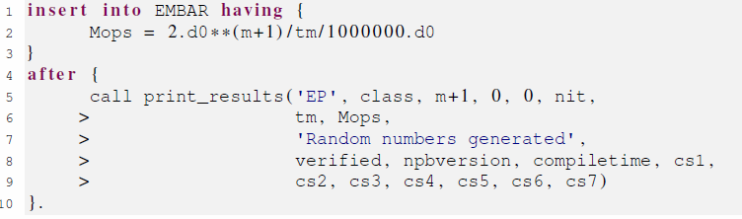
Stage 1. Modulo-F
Modulo-F example 1:
Implementing user-level checkpointing

Slide 66
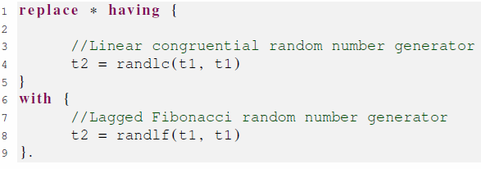
Stage 1. Modulo-F
Modulo-F example 2:
Alternate implementation of random function

Slide 67
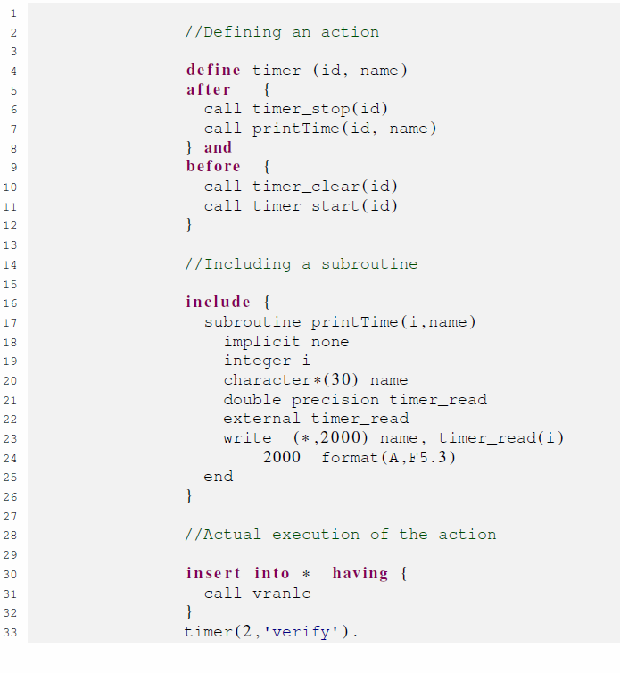
Modulo-F example 3:
Implementing timer using Modulo-F

Slide 68
Stage 1. Implementation of Modulo-F
Generate TXL files
Modulo-F Parsing
Modulo-F file
Template
Template Store
TXL file
FORTRAN target
TXL engine
FORTRAN source

Slide 69
Stage 1. Modulo-F
Modulo-F Summary
Introduced a simple transformation language called Modulo-F.
Modulo-F can modularize
Sequential sections
Utility functions
Parallel sections
Improve code readability and evolution, without affecting the core computation.
A case study involving programs from the NAS parallel benchmarks was conducted to illustrate the features and usefulness of this language.

Slide 70
Stage 2. tPPModel
Modeling parallel programs using tPPModel
To separate the parallel sections from the sequential parts of a program – Markers in the original program.
To map and define a new execution strategy for the existing hotspots without changing the behavior of the program – Creating abstract functions.
To generate code from templates to bridge the parallel and sequential sections – Generating a Makefile.

Slide 71
Related works
Compared to domain-independent workflows like JBPM and Taverna, our framework has the advantage that it is configured only for scientific signature discovery workflows.
Most of these tools assume that the web services are available. Our framework configures the workflow definition file that declares how to compose services wrappers created by our framework.

Slide 72
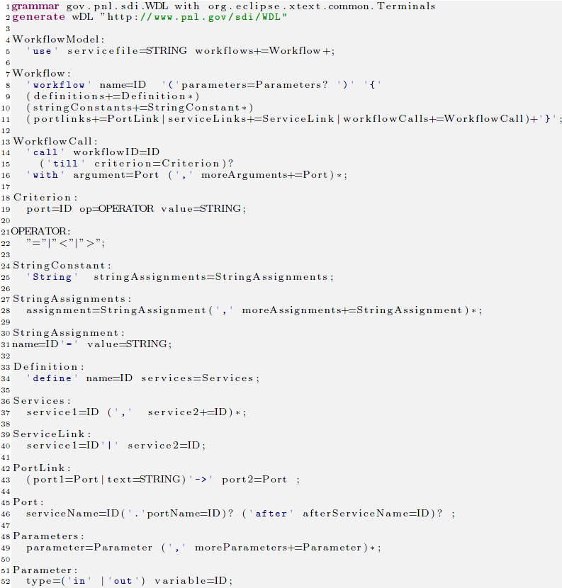
Xtext grammar for WDL

Slide 73
An overview of SDL code generation
No | Service | Utils/Script | {Inputs (type)] [Outputs(type)] | LOC | Total LOC (files)
1 | echoString | echo | [0][1 (doc)] | 10+13+1+6 | 30(4)
2 | echoFile | echo | [1 (String)] [1 (doc) ] | 10+14+1+6 | 31(4)
3 | aggregate | cat | [1(List doc) ] [1 (doc) ] | 10+20+1+7 | 38(4)
4 | classifier_Training | R | [2 (doc), 1 (String) ] [1 (doc) ] | 11+24+2+8 | 45(4)
5 | classifier_Testing | R | [3 (doc), 1 (String) ] [1 (doc) ] | 12+29+2+8 | 51(4)
6 | accuracy | R | [1 (doc) ] [1 (doc) ] | 11+19+1+6 | 37(4)
7 | submitBlast | SLURM, sh | [3 (doc) ] [2 (String) ] | 17+27+2+8+18 | 72(5)
8 | jobStatus | SLURM, sh | [1 (String) ] [1 (String) ] | 10+14+1+6 | 31(4)
9 | blastResult | cp | [1 (String) ] [1 (doc) ] | 10+14+1+6 | 31(4)
10 | mafft | mafft | [1 (doc) ] [1 (doc) ] | 10+18+1+6 | 35(4)

Slide 74
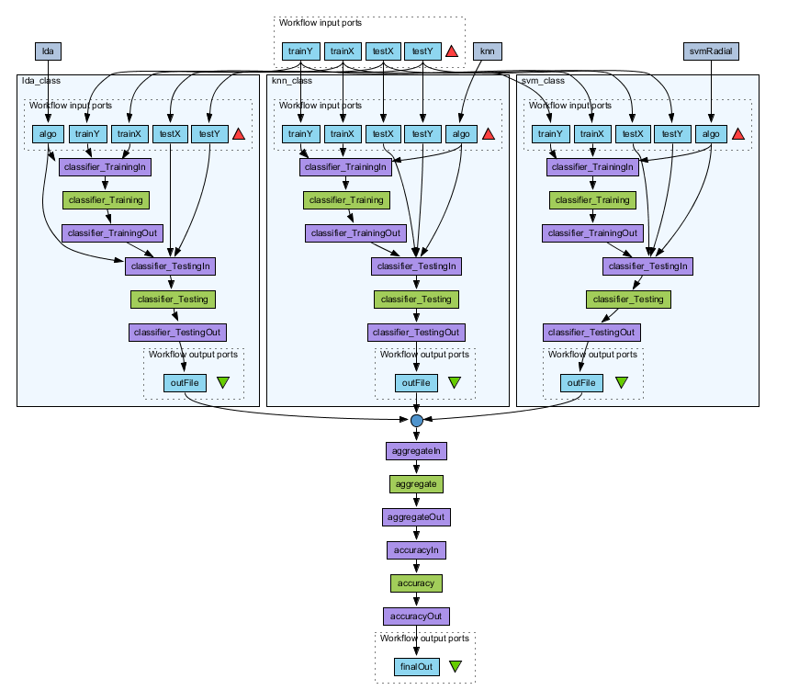
Taverna classification workflow

Slide 75

MapRedoop- Casestudy: K-means

Slide 76

SDL WDL Casestudy Landscape classification

Slide 77

PNBsolver Implementation

Slide 78

PNBsolver Effect of theta in Error and Time

Slide 79

PNBsolver: Speedup of MPI and OMP

Slide 80
Parallel programming languages
Automatic Translation
Parallel logic
GPU
Computer-specific
Architecture-specific
Task and Data parallel
Template
Sequential to parallel converters
Languages tailored for a specific computer
OpenMP, MPI
Using parallelism in data and tasks
Skeleton of the program is provided
Specification is in first order logic
Cg, CUDA. OpenCL

